Slide 1
PROJECT 4: AMAZON – IPHONE 13 REVIEWS - NLP
Emir Nalıncıoğlu– Hasan Enes Güray – Merve Sarı

Slide 2



Project Flow
Problem/Need
Proposal/Resources
Data Analysis
Solution
Detection of solution proposals and obtaining necessary data
Cleaning and enriching the collected data
A model that reveals good or bad reviews from customer reviews
Understanding better customer attitude and behavior

Slide 3


Problem/Need
Amazon wants to analyze the sentiment analysis of customer reviews on products to better understand customer attitude and behavior
Pilot product: iPhone 13
Pilot region: United Kingdom
What are people’s favorite features about these mobile phones? or what they complain about the most?
Problem
How to develop a model to predict the mood of a review automatically?

Slide 4

Proposals/Resources
Identification of all pilot products in the designated pilot region and examination of customer comments with stars
We will use the following data sources to provide a solution to this problem.
63 different products
13120 customer reviews (Positive: 0.81379, Negative: 0.18621)

Slide 5



Data Scraping and Storage
We scraped all of the data thanks to BeautifulSoup library of Python and .

Slide 6





Data Analysis
We cleaned, organized and visualized the data using the following tools to propose a solution.
Data
Analysis
Tools

Slide 7



Model Preperation
Before putting it into the model, we should clear our text from special characters, emoji, stop_words, numbers and remove the case separation so that the model does not perceive the same word as different.
Also, separating the roots of the words will reduce the number of words we will include in the model.
We used SnowballStemmer, TextBlob for NLP and LogisticRegression to prepare our model.
NLP & Model Building

Slide 8

Model Production
We built a web page via Streamlit for customer interface of our model.

Slide 9
Retrieval of data
Data Analysis Process
Step 1
Data scraping, formatting and exploratory data analysis
Step 2
Using SnowballStemmer and TextBlob to get word roots
Step 3
Converting the text to numerical feature vectors via Tfidf and CountVectorizer
Step 4
Build different regression models and compare the results
Step 5
Producing our model by creating a customer interface

Slide 10
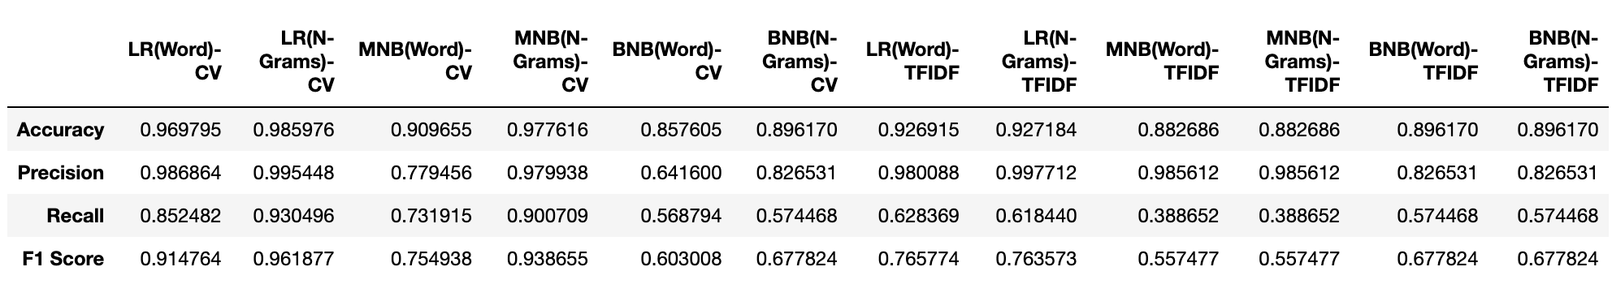
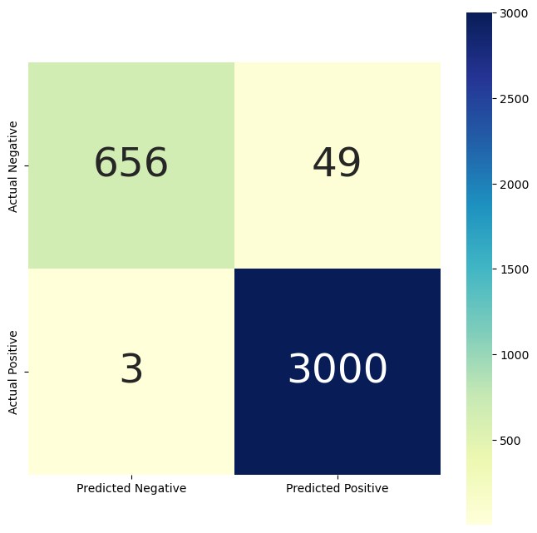
Retrieval of data
Model Results
MultinomialNB
BernoulliNB
Logistic Regression
Count Vectorizer
TFIDF Vectorizer
Word
N-Gram(1,2)

Slide 11
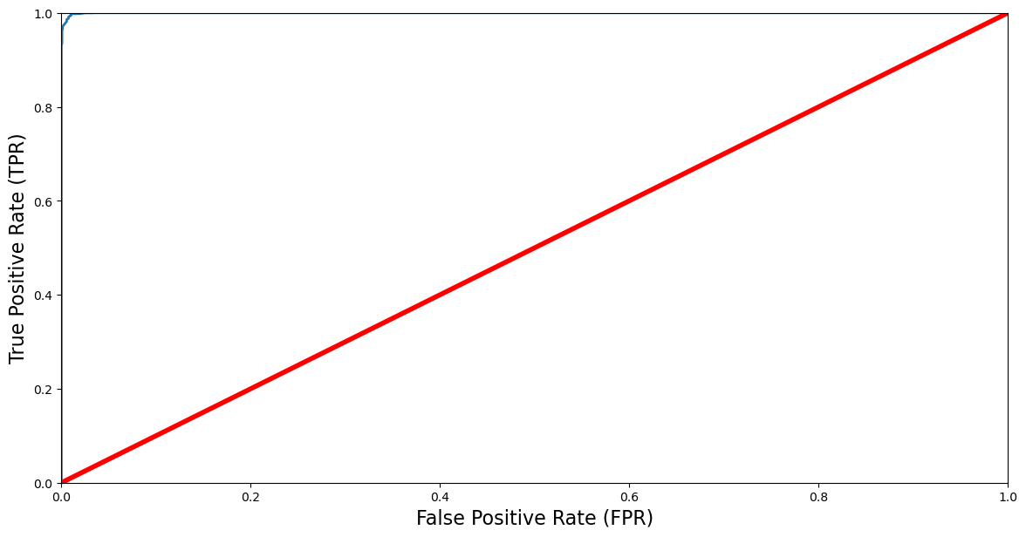
Retrieval of data
Model Results
ROC-AUC Score: 0.9997638271916854

Slide 12
Retrieval of data
Cross Validation Results
Accuracy
Mean: 0.9826574876900022
Standard Deviation: 0.005090622427970945
Recall
Mean: 0.9980151889578688
Standard Deviation: 0.0015784260454636513
Precision
Mean: 0.981076367232815
Standard Deviation: 0.0055858512912471455
F1
Mean: 0.9894654177499216
Standard Deviation: 0.0030687108688973136

Slide 13
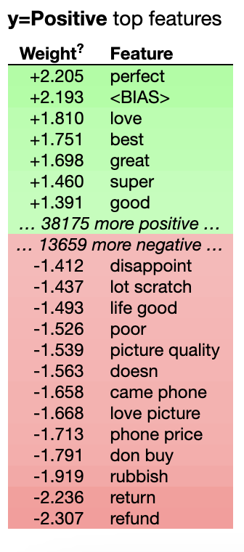
Retrieval of data
Feature Importance

Slide 14

If we…
Had more time we could;
Scraping more data from different web sites
Using oversampling or undersampling methods
Can use and compare the results of other Stemmers like LancasterStemmer
Trying different regression models with specific parameters

Slide 15

Finally

